Slide 1

Fantasy league Team - 15
Apuru Rohan (098)
Srinivas Reddy(113)
Pavan kumar(090)
Sagar amruth(066)

Slide 2
Actors wise use cases
Player
Login
Leader board
Match bet
Questions
Admin
Leader board
Match setup
Results

Slide 3
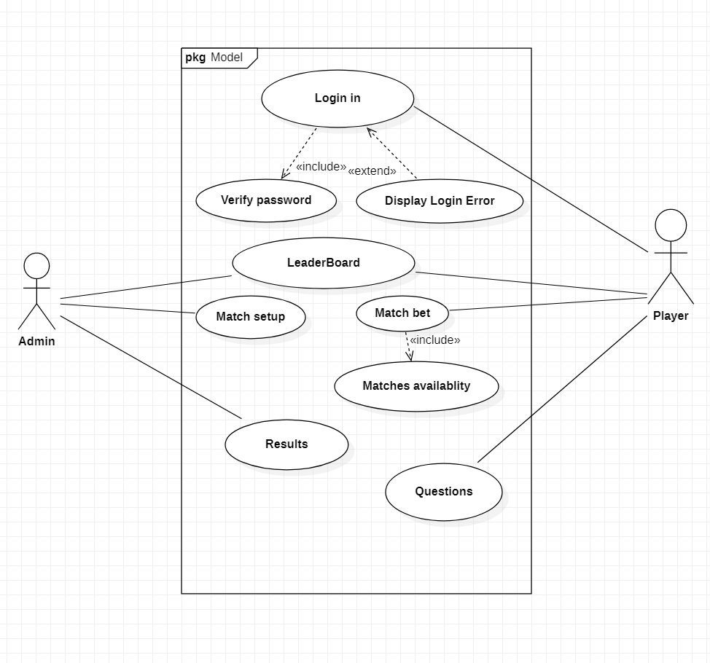
Use case diagram

Slide 4
Use Case ID: UC01 Name: Registering Actors: Player Description: Allows the user to register himself. Pre-conditions: None Post-conditions: Account will be created for the user. Main Flow:
User | System
1. Enter the user name and password for registering.
 | 2. The system will create an account and adds an initial balance of 100 coins.

Slide 5
Use Case ID: UC02 Name: Login Actors: Player Description: Allows the user to login into his account. Pre-conditions: The player must have a registered account. Post-conditions: The user logs in. Main Flow:
User | System
1.Enters username and password and choses the login option.
 | 2.Validates username and password. 2.1)If the username or password is invalid, display error message and prompt for valid username or password. 2.2) If the username and password are valid, then login and display the home page.

Slide 6
Use Case ID: UC03 Name: Leader Board Actors: Player and Admin Description: Allows the actor to view the leaderboard positions Pre-conditions: The actor player must login Post-conditions: The leader board is displayed Main Flow:
User | System
1. User taps on the leader board .
 | 2. The system performs the required action and displays the leaderboard of the registered users.

Slide 7
Use Case ID: UC04 Name: Match Bet Actors: Player Description: Checks for match availability and displays the matches Pre-conditions: The player must login Post-conditions: The matches will be displayed onto the screen Main Flow:
User | System
1.Player clicks on the matches available button
 | 2. 1) If the matches are not available then it displays no matches are available. 2. 2) If the matches are available then it displays the available matches.

Slide 8
Use Case ID: UC05 Name: Questions Actors: Player Description: Allows the player to invest his coins on the respective options Pre-conditions: The matches must be available. Post-conditions: The investment amount will be saved. Main Flow:
User | System
1. Players will invest the coins on the options.
 | 2. The amount invested by the player will be saved in their account.

Slide 9
Use Case ID: UC06 Name: Match Setup Actors: Admin Description: Allows the admin to set the match. Pre-conditions: None Post-conditions: The match will be set up by the admin. Main Flow:
User | Admin
1. The admin will sets the match between two teams.
 | 2. The matches will be set and will be ready for the players.

Slide 10
Use Case ID: UC07 Name: Results Actors: Admin Description: The result of the match will be published by feeding the correct options. Pre-conditions: There must be a match for which the results are not declared yet. Post-conditions: The results will be declared and the leaderboard will be updated. Main Flow:
User | System
1. The admin will declare the results of the match.
 | 2. 1) The result of each match will be displayed. 2. 2) The updated leader board will be displayed.

Slide 11
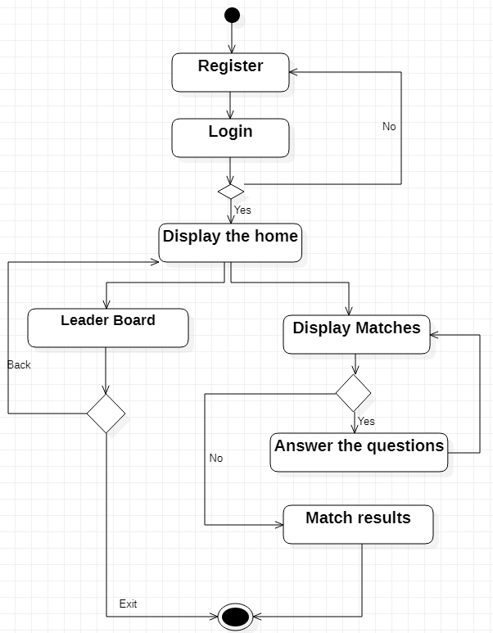
Activity Diagram

Slide 12


